Slide 1
​​Write Shell Scripts Using JavaScript and zx
John M. Wargo
@johnwargo
https://johnwargo.com

Slide 2
Abstract
There are many ways to automate stuff when you're building and writing software, shell scripts, CI/CD, command-line utilities, and more.
When you need to run something locally, developers often turn to shell scripts for something simple and node-based command-line utilities for more complicated tasks.
Google's zx project sits right between those two options, merging shell commands spawning external apps with JavaScript (or even TypeScript) coding.
In this session, you'll learn how to write shell scripts using JavaScript and zx (plus a little more).

Slide 3
Disclaimer: Spawn Only
The open source modules discussed in this session simplify Node-based apps spawning external processes and related stuff.
Neither provides JavaScript access to Shell commands (ls, cd, etc.).
Node already has something for that:
The fs library included with node.
For additional capabilities, use the fs_extra module.

Slide 4
Agenda
Introduction
Scripts Across Platforms
An Introduction to zx
Coding with John
An Introduction to Execa
More Coding with John
Wrap Up
This is going to move pretty fast!
Will not be a thorough deep-dive, will just introduce you to two useful open-source libraries that may make your life easier.

Slide 5
Resources
Presentation:
Source code: https://bit.ly/ato23-shell-scripts

Slide 6
Introduction

Slide 7

About Me
Software developer, writer, presenter, father, husband, geek.
Principle Product Manager at Oracle Cloud Infrastructure (OCI).
Author of 7 (+1)* books.
Live in Charlotte, NC.
Previously @ AT&T, BlackBerry, BoxTone, Forrester Research, GitHub, Hewlett Packard Enterprise (HPE), Microsoft, SAP, & others. I apparently can’t keep a job.

Slide 8
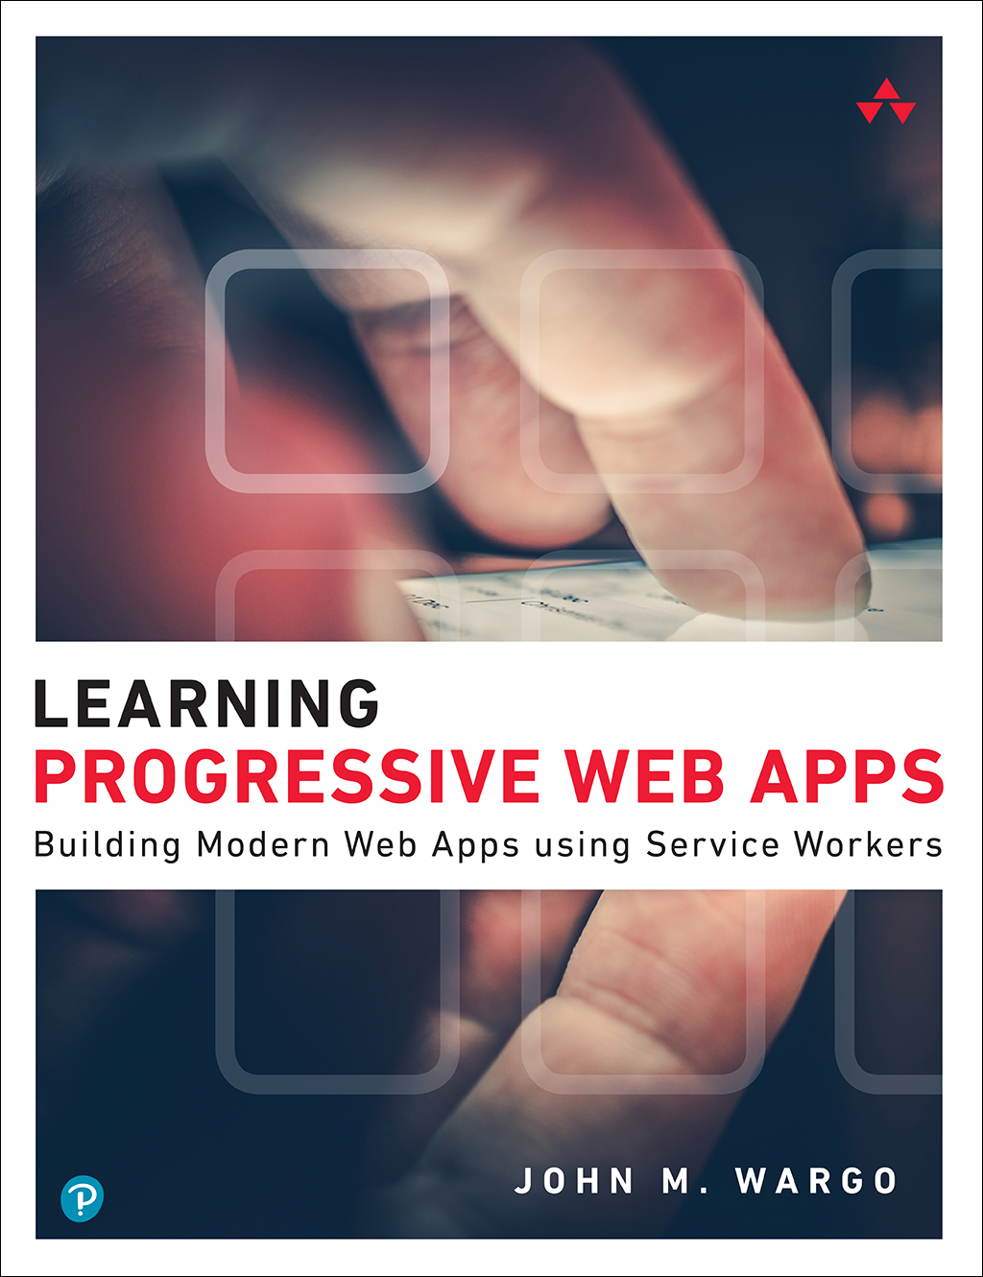
Learning Progressive Web Apps
https://learningpwa.com/

Slide 9
Scripts Across Platforms
Doing things the hard way

Slide 10
Developer Task Automation
Developers have all sorts of tools available to them to automate development associated tasks:
Batch files
Shell Scripts
Git-based workflows
CI/CD
All sorts of stuff

Slide 11
Batch Files and Shell Scripts
Command files and shell scripts are a quick way to hack together a bunch of commands to get something done.
However, if you work on Windows and macOS and/or Linux, then you’re creating two files to accomplish the same task on Windows and *nix systems (.cmd and .sh files).
Also, the languages used in each is very different.

Slide 12
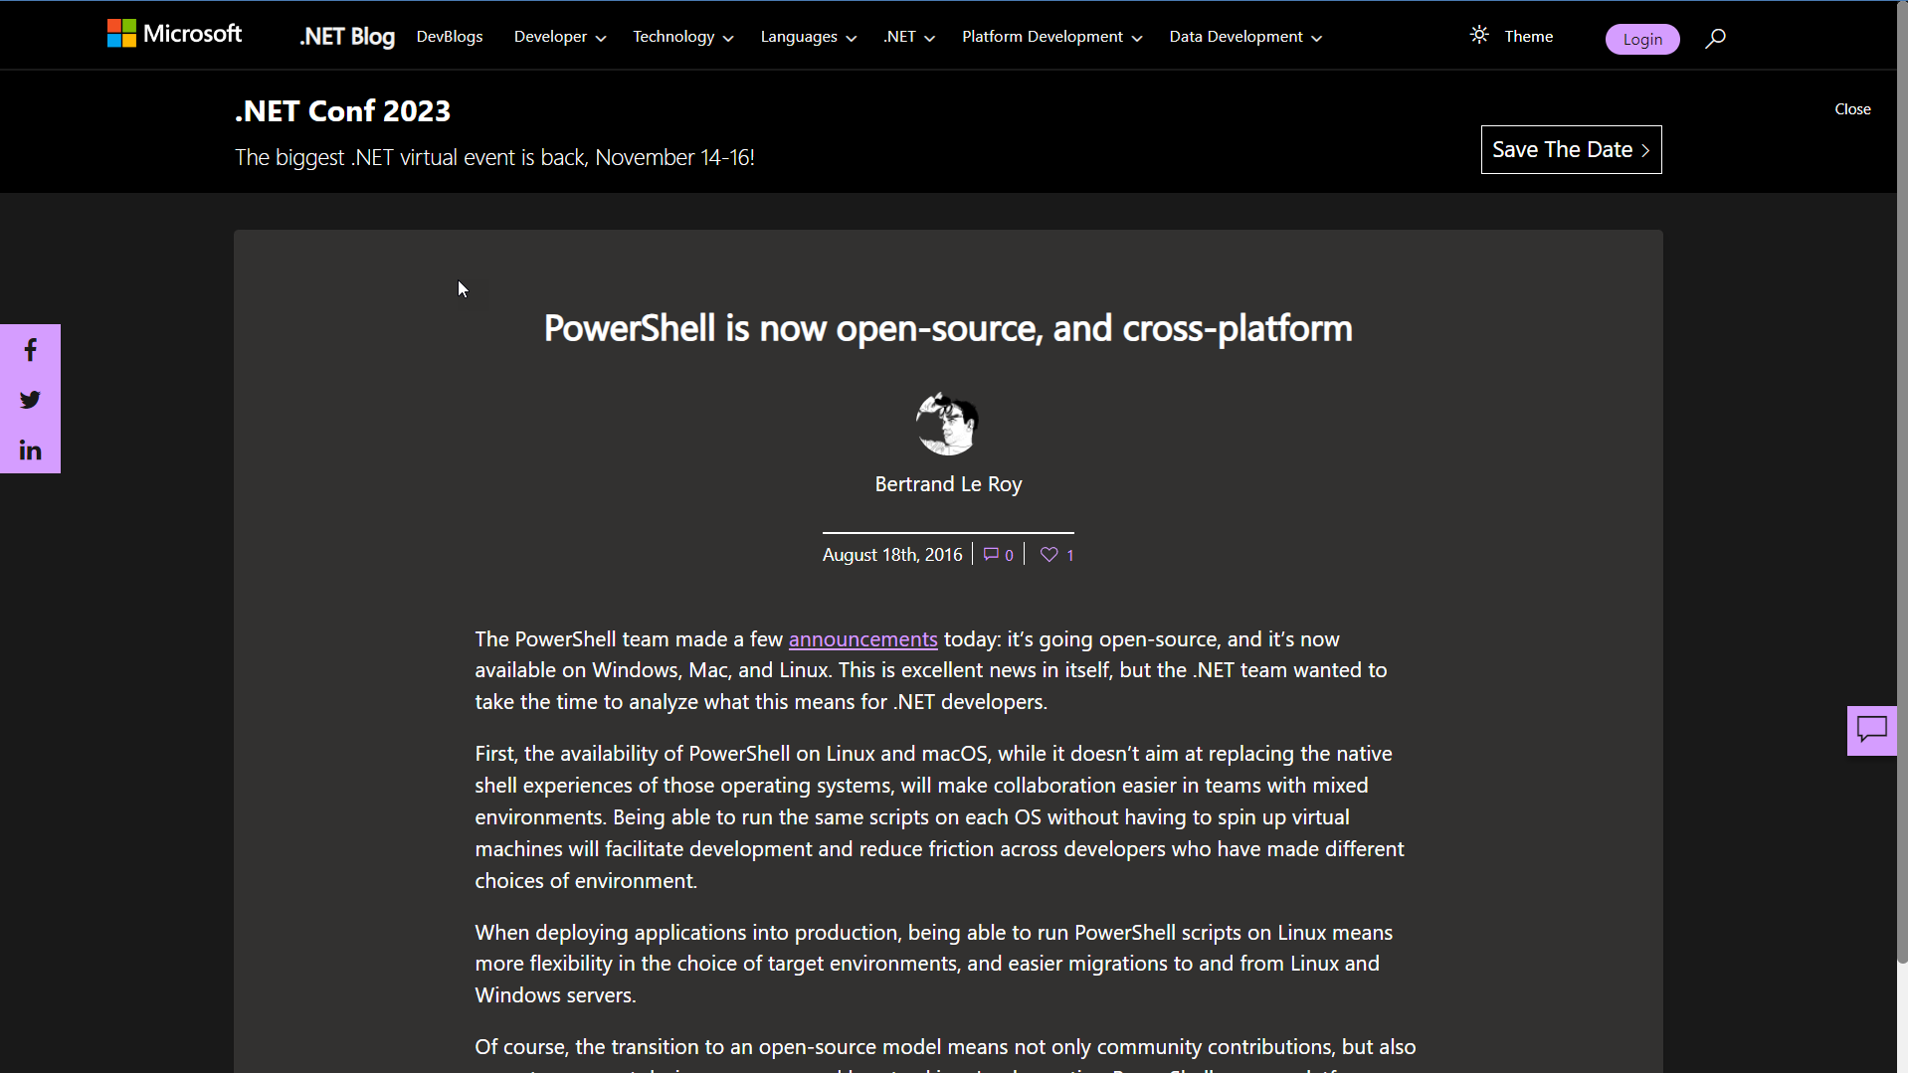

Slide 13
What about PowerShell?
Yes, you can use PowerShell to write cross-platform scripts.
But this session isn’t about PowerShell.
This session is about node.js and JavaScript.

Slide 14
JavaScript and TypeScript
As a JavaScript/TypeScript developer, I frequently turn to node.js and for task automation.
This works well, but has some overhead…

Slide 15
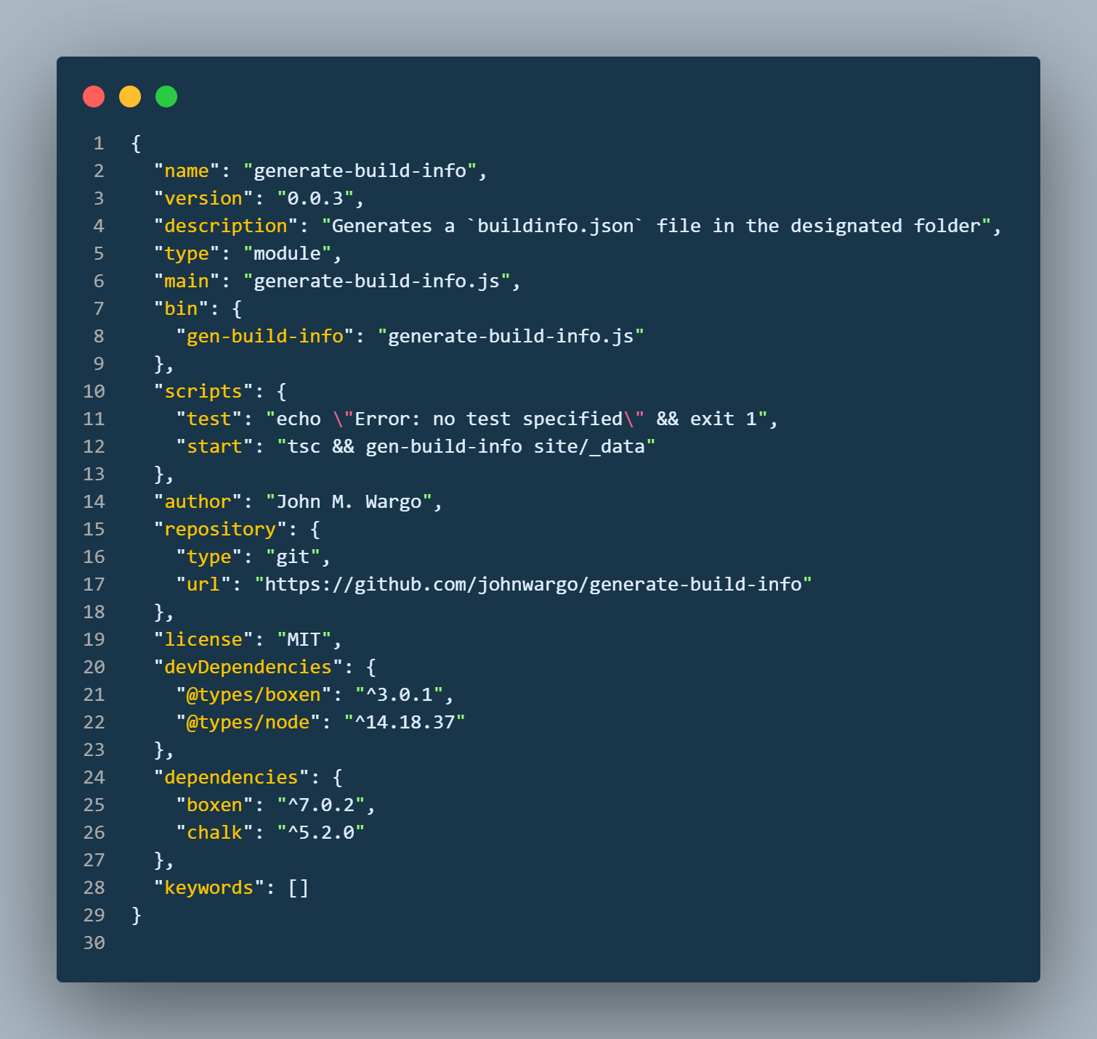

Slide 16
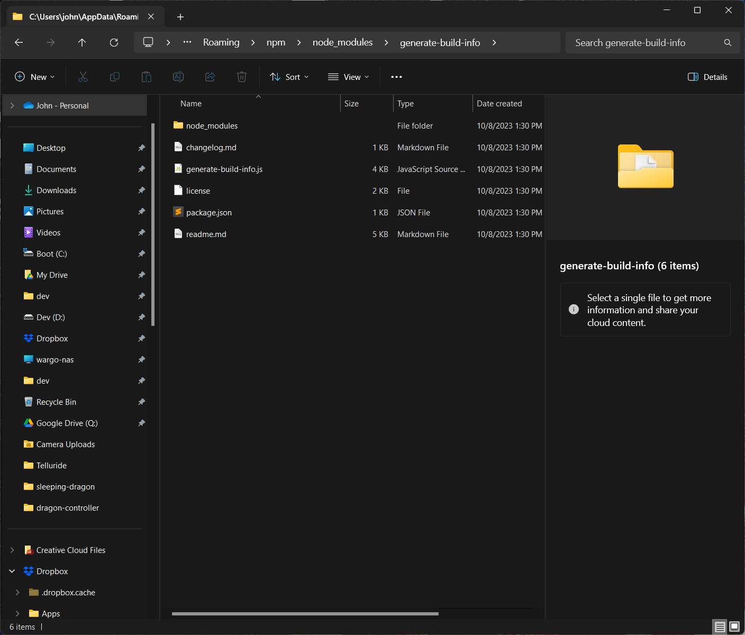

Slide 17
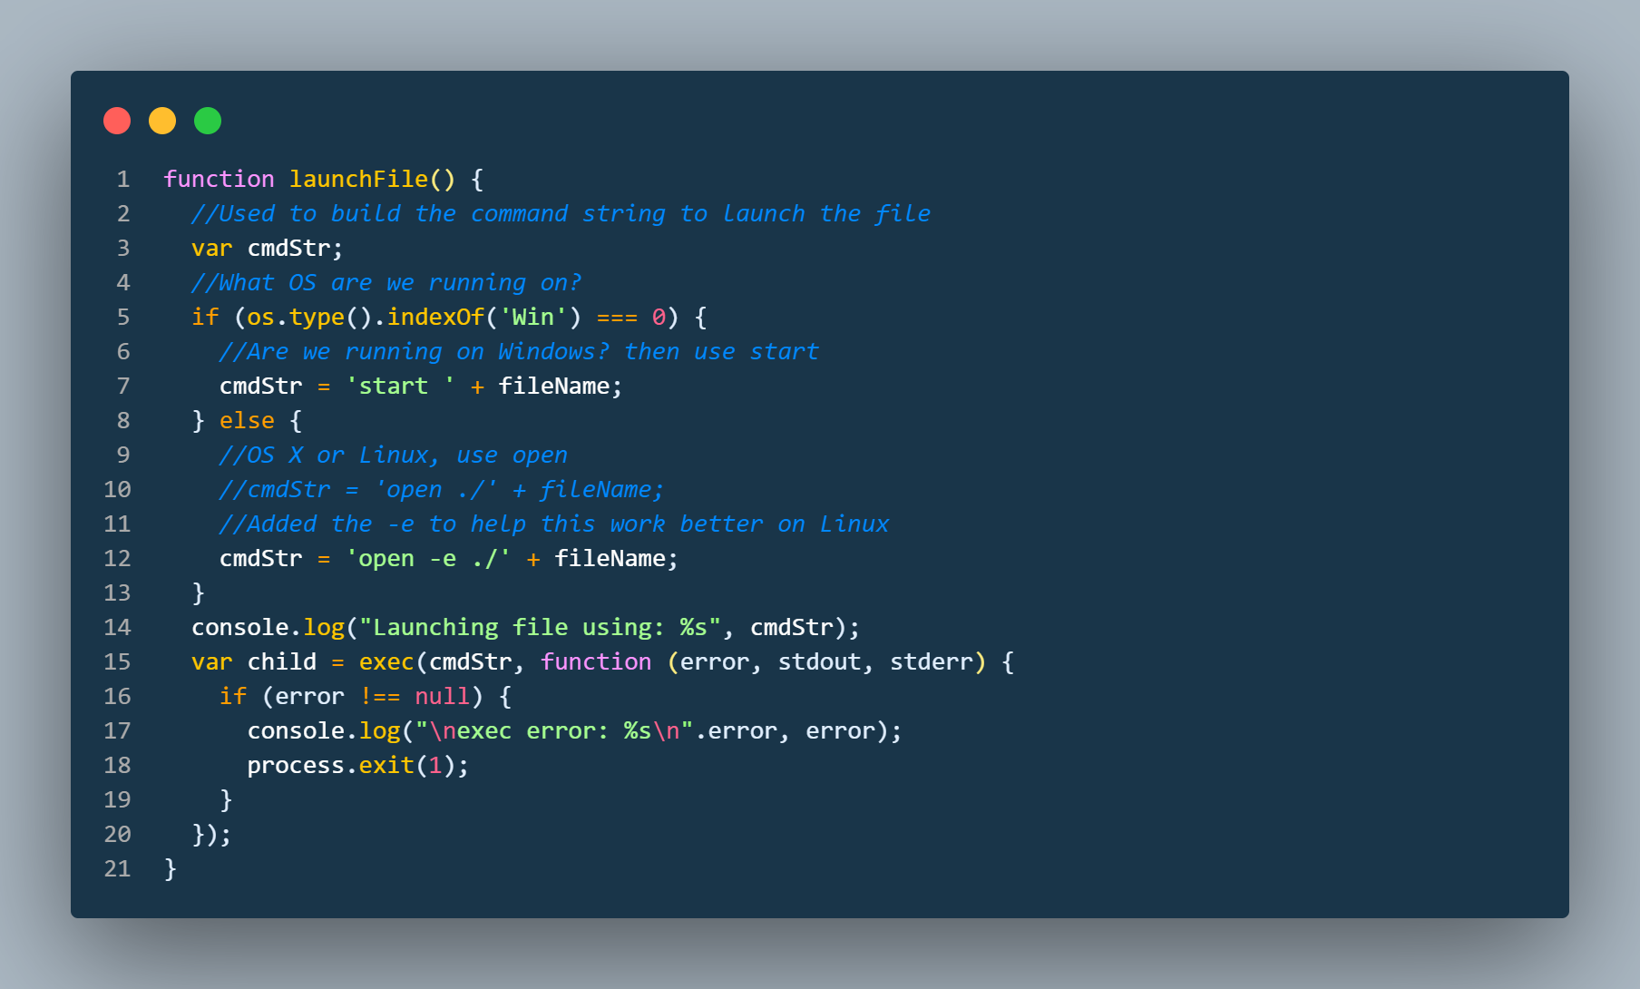

Slide 18
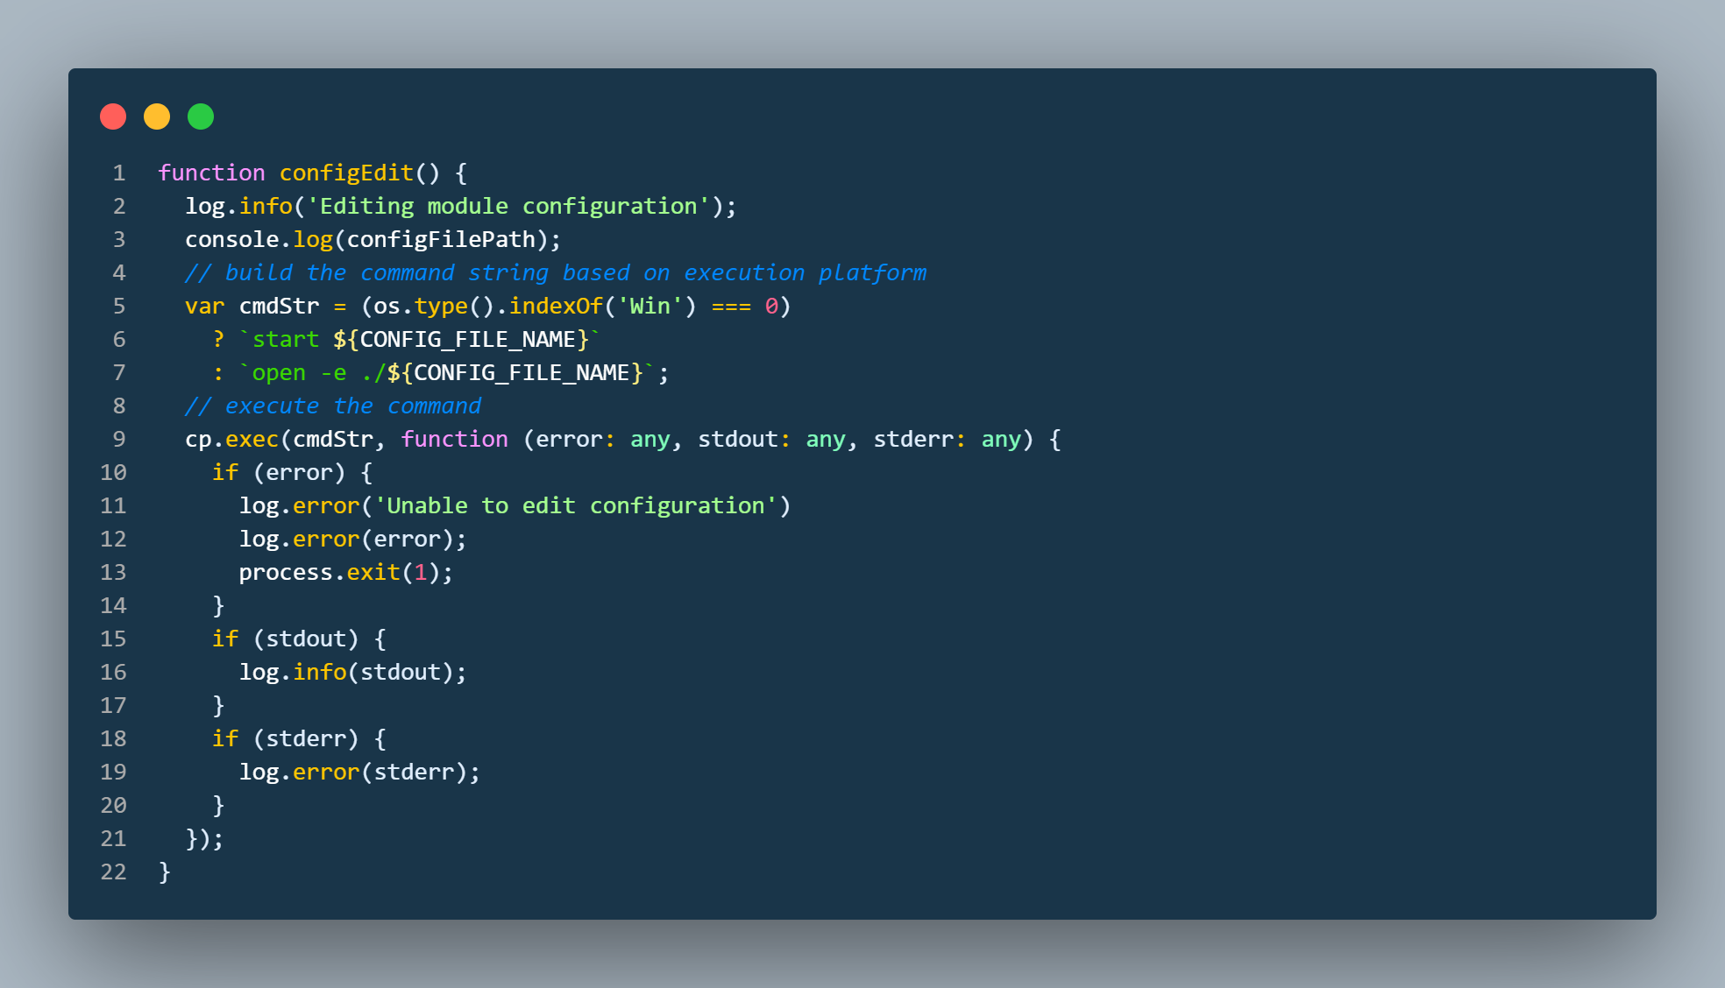

Slide 19
What I want…
A way to write shell scripts for multiple platforms:
At a minimum Microsoft Windows
Support macOS and/or Linux too
Stand-alone scripts, no overhead files polluting the current project folder.
No new language learning.
Support for asynchronous tasks.

Slide 20
Introducing ZX

Slide 21
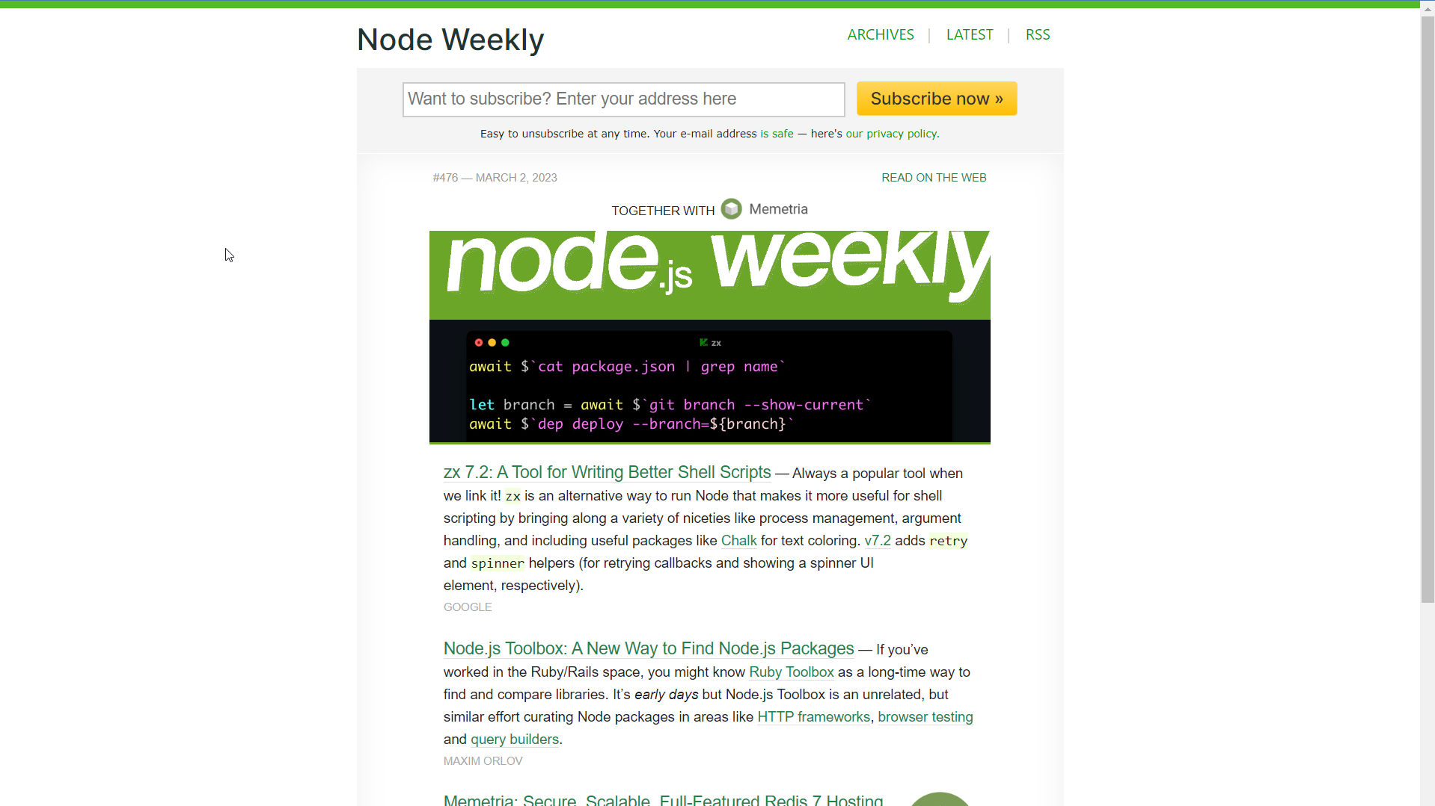

Slide 22
google/zx
https://github.com/google/zx
From the Repo:
Bash is great, but when it comes to writing more complex scripts, many people prefer a more convenient programming language.
JavaScript is a perfect choice, but the Node.js standard library requires additional hassle before using.
The zx package provides useful wrappers around child_process, escapes arguments and gives sensible defaults.”

Slide 23
What is zx?
(my words) It’s a node-based runtime for executing JavaScript-based scripts.
Installs and executes globally (it’s a runtime after all)
Provides a simplified wrapper around node’s child_process API.
Returns promises from calls to spawn.
Automatically initializes several standard node modules (chalk, fetch, fs_extra, minimist).
Automatically escapes and quotes parameters.
This isn’t a complete analysis, so let's look at the docs.

Slide 24
Coding With John
Part 1

Slide 25
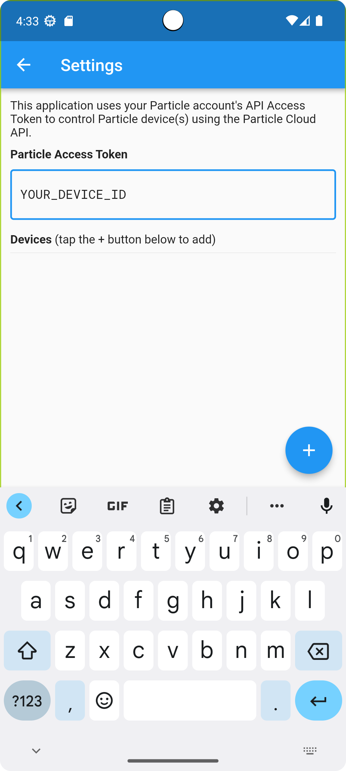
Example #1
I have this flutter app…
During testing, I paste specific text into several input fields.
Fortunately, the Android SDK provides a command-line tool I can use to poke content in the keyboard buffer.

Slide 26

Let’s Look At Some Code
Photo by Walkator on Unsplash

Slide 27
Example #2
Client-side build steps for a JavaScript-based Static Site Generator (SSG) project.
Don’t run the same steps every time, so need some flexibility in controlling what runs.
Since it’s already a JavaScript project, zx fits right in.

Slide 28
Let’s Look At Some Code
Photo by Walkator on Unsplash

Slide 29
zx Summary
Pros
Cons
Quick, simple, and easy.
Automatic initialization of standard modules simplifies code.
Robust options for output management.
Doesn’t expect to run in a nod-based project.
A separate runtime environment/command
Haven’t been able to figure out how to run without the zx command (./script.mjs)

Slide 30
Introducing Execa

Slide 31
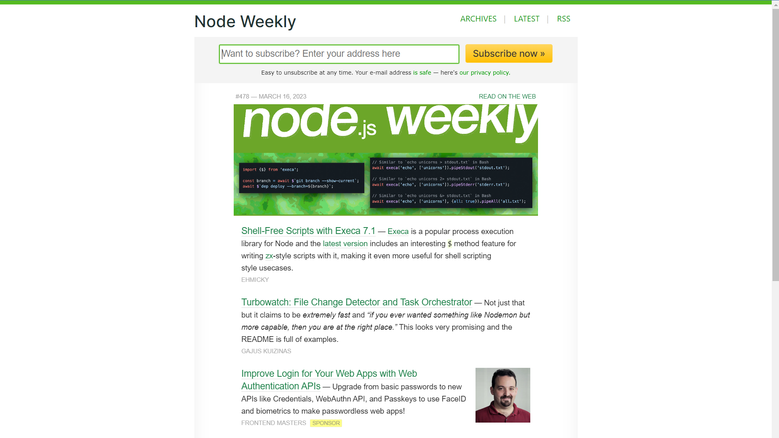

Slide 32
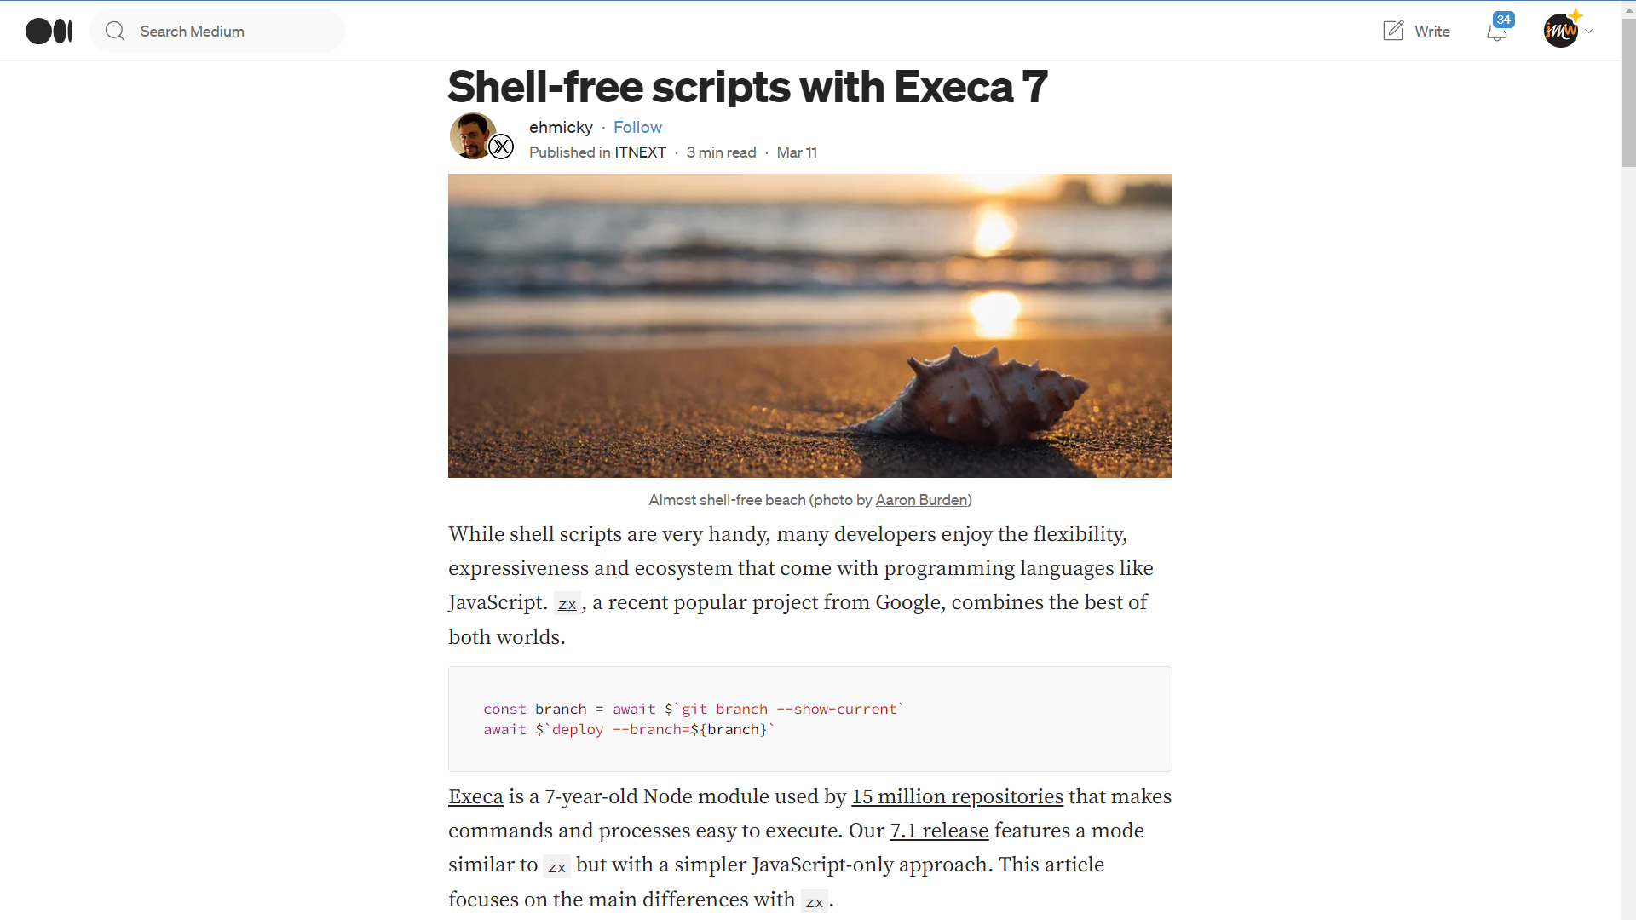

Slide 33
Execa
Delivers a wrapper around the Node’s child_process API
Provides promise interface
Expects to be installed locally and must be imported (just like other node modules used in your app).
Expects to execute in a node project folder

Slide 34
Execa (continued)
Execa execution method.
Recently added zx-style execution as well.
Executes silently generally.
This isn’t a complete analysis, so let's look at the docs.

Slide 35
Coding With John

Slide 36
Execa Summary
Pros
Cons
Can work like zx if you want
Node-centric.
Must install dependencies in project folder.
No automatic initialization of chalk, fetch, fs_extra, and minimist.
Manual echo of executing task.

Slide 37
Questions?

Slide 38
Resources
Presentation:
Source code: https://bit.ly/ato23-shell-scripts

